Slide 1
Star Schema Basics
Kiryl Bucha
U1M6.Star Schema Basics

Slide 2
Overview
The Object Data Model
The Dimensional Data Model
The Star Schema
The Snowflake Schema

Slide 3
The Object Data Model

Slide 4
The Object Data Model
Class is the equivalent of a relational entity or table. It is important to understand that a class is not the same as an object.
Attribute is equivalent to a column in a relational entity column or field.
Method is a chunk of code or program executed exclusively on the contents of the object to which it is attached.
Inheritance, Classes are linked together through an inheritance hierarchy.
Multiple Inheritance, Multiple inheritance allows a class to inherit details from more than one class.
Specialization and Abstraction, The result of inheritance is that classes can be both specialized and abstracted.
Collection is the term applied to a repetition of elements of one object contained within another object.

Slide 5
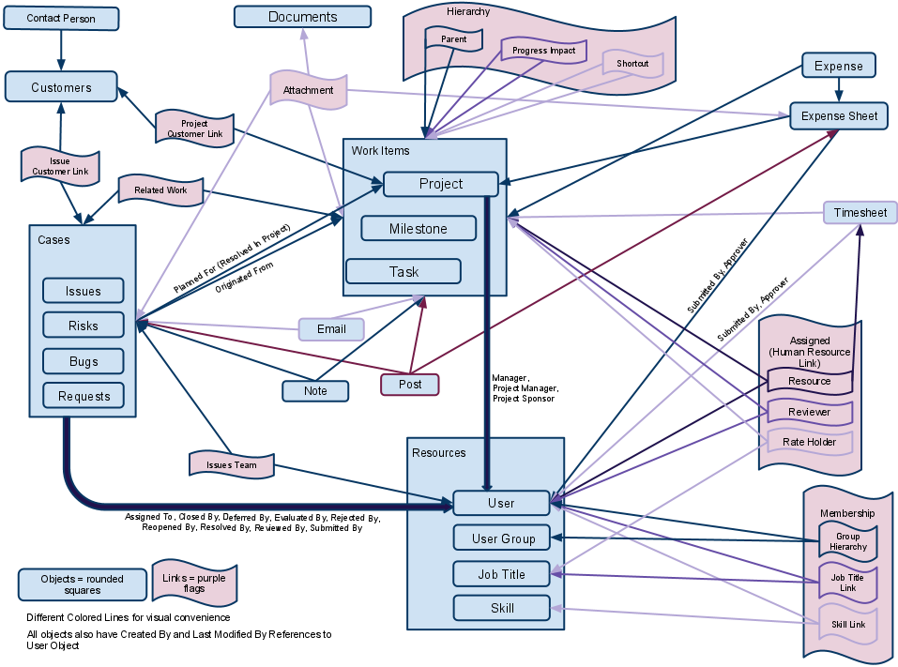
The Object Data Model – Example

Slide 6
The Dimensional Data Model

Slide 7
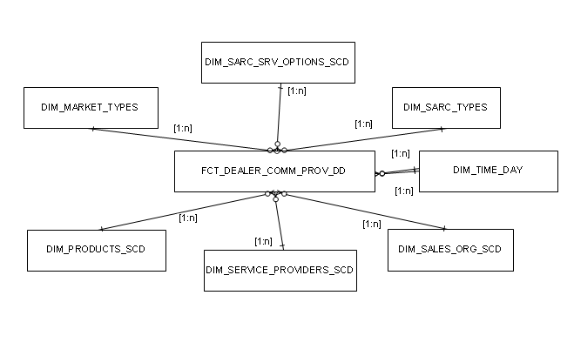
The Dimensional Data Model
The dimensional model is scheme with dimensions surrounding the fact table. To build the schema, the following design model is used:
Choose the business process
Declare the Grain
Identify the Fact
Identify the dimensions

Slide 8
The Star Schema

Slide 9
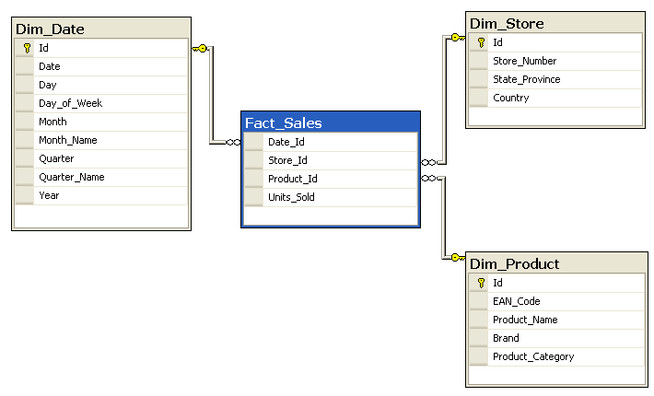
The Star Schema
The star schema is the simplest data warehouse schema. It is called a star schema
because the diagram resembles a star, with points radiating from a center. The
center of the star consists of one or more fact tables and the points of the star are the
dimension tables
Star

Slide 10
The Snowflake Schema

Slide 11
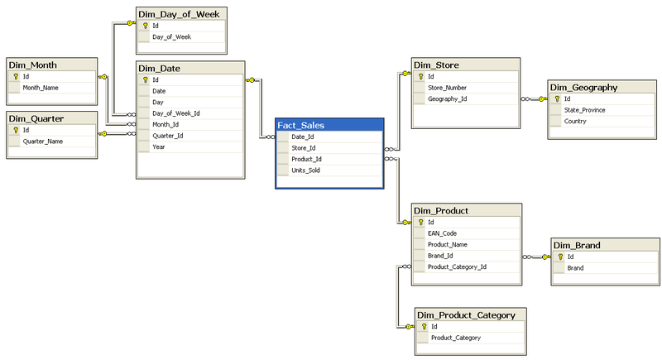
The Snowflake Schema
Snowflake schemas are often better with more sophisticated query tools that create a layer of abstraction between the users and raw table structures for environments having numerous queries with complex criteria.
Snowflake

Slide 12
Thank you Time for questions
Kiryl Bucha
U1M6.Star Schema Basics

